Slide 1
Kinematic Presentation Tom
5/19/25

Slide 2
Completed:
Velcro testing on length samples
Different way of plotting train one sample and apply model on reapplied and misaligned samples
Testing Current Source Circuit. Provides INCREDIBLY LOW NOISE DATA. Will use for PCB design but not for camera design to keep circuit consistent with bench top testing
Circuit design for 4 strain sensors
Order Camera equipment
Begin programming python code for data acquisition

Slide 3
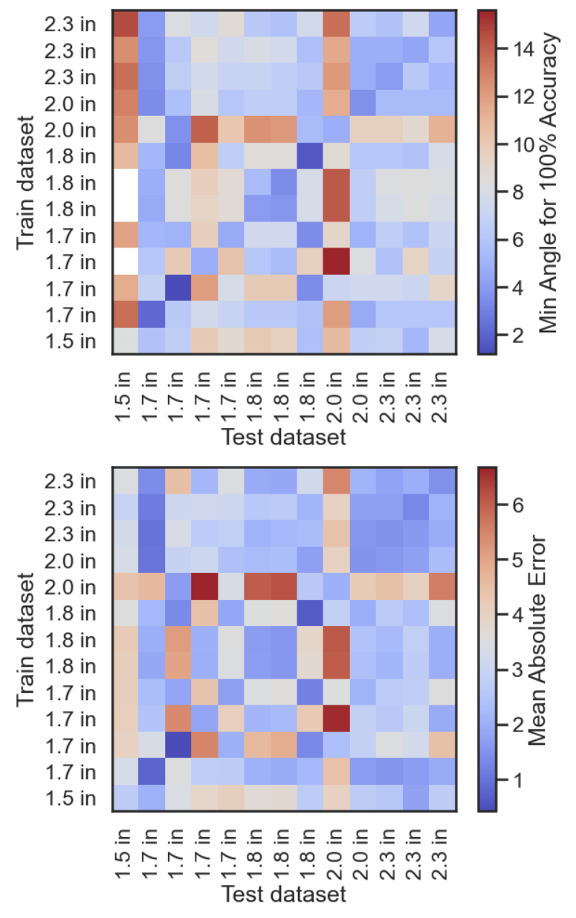
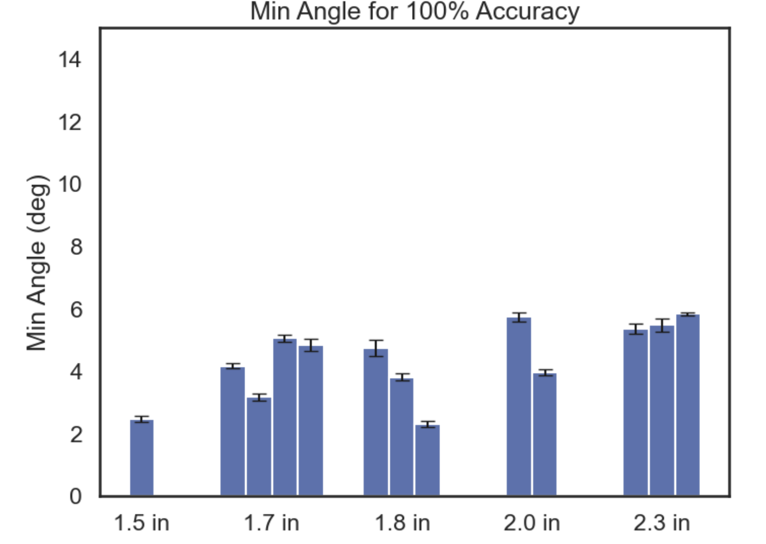
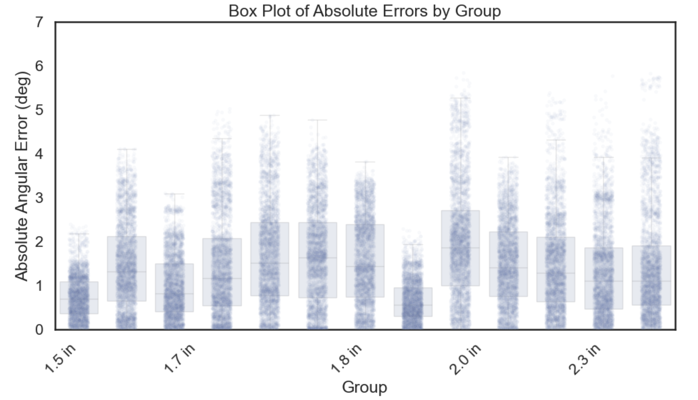
Length Data Tested Using Velcro

Slide 4
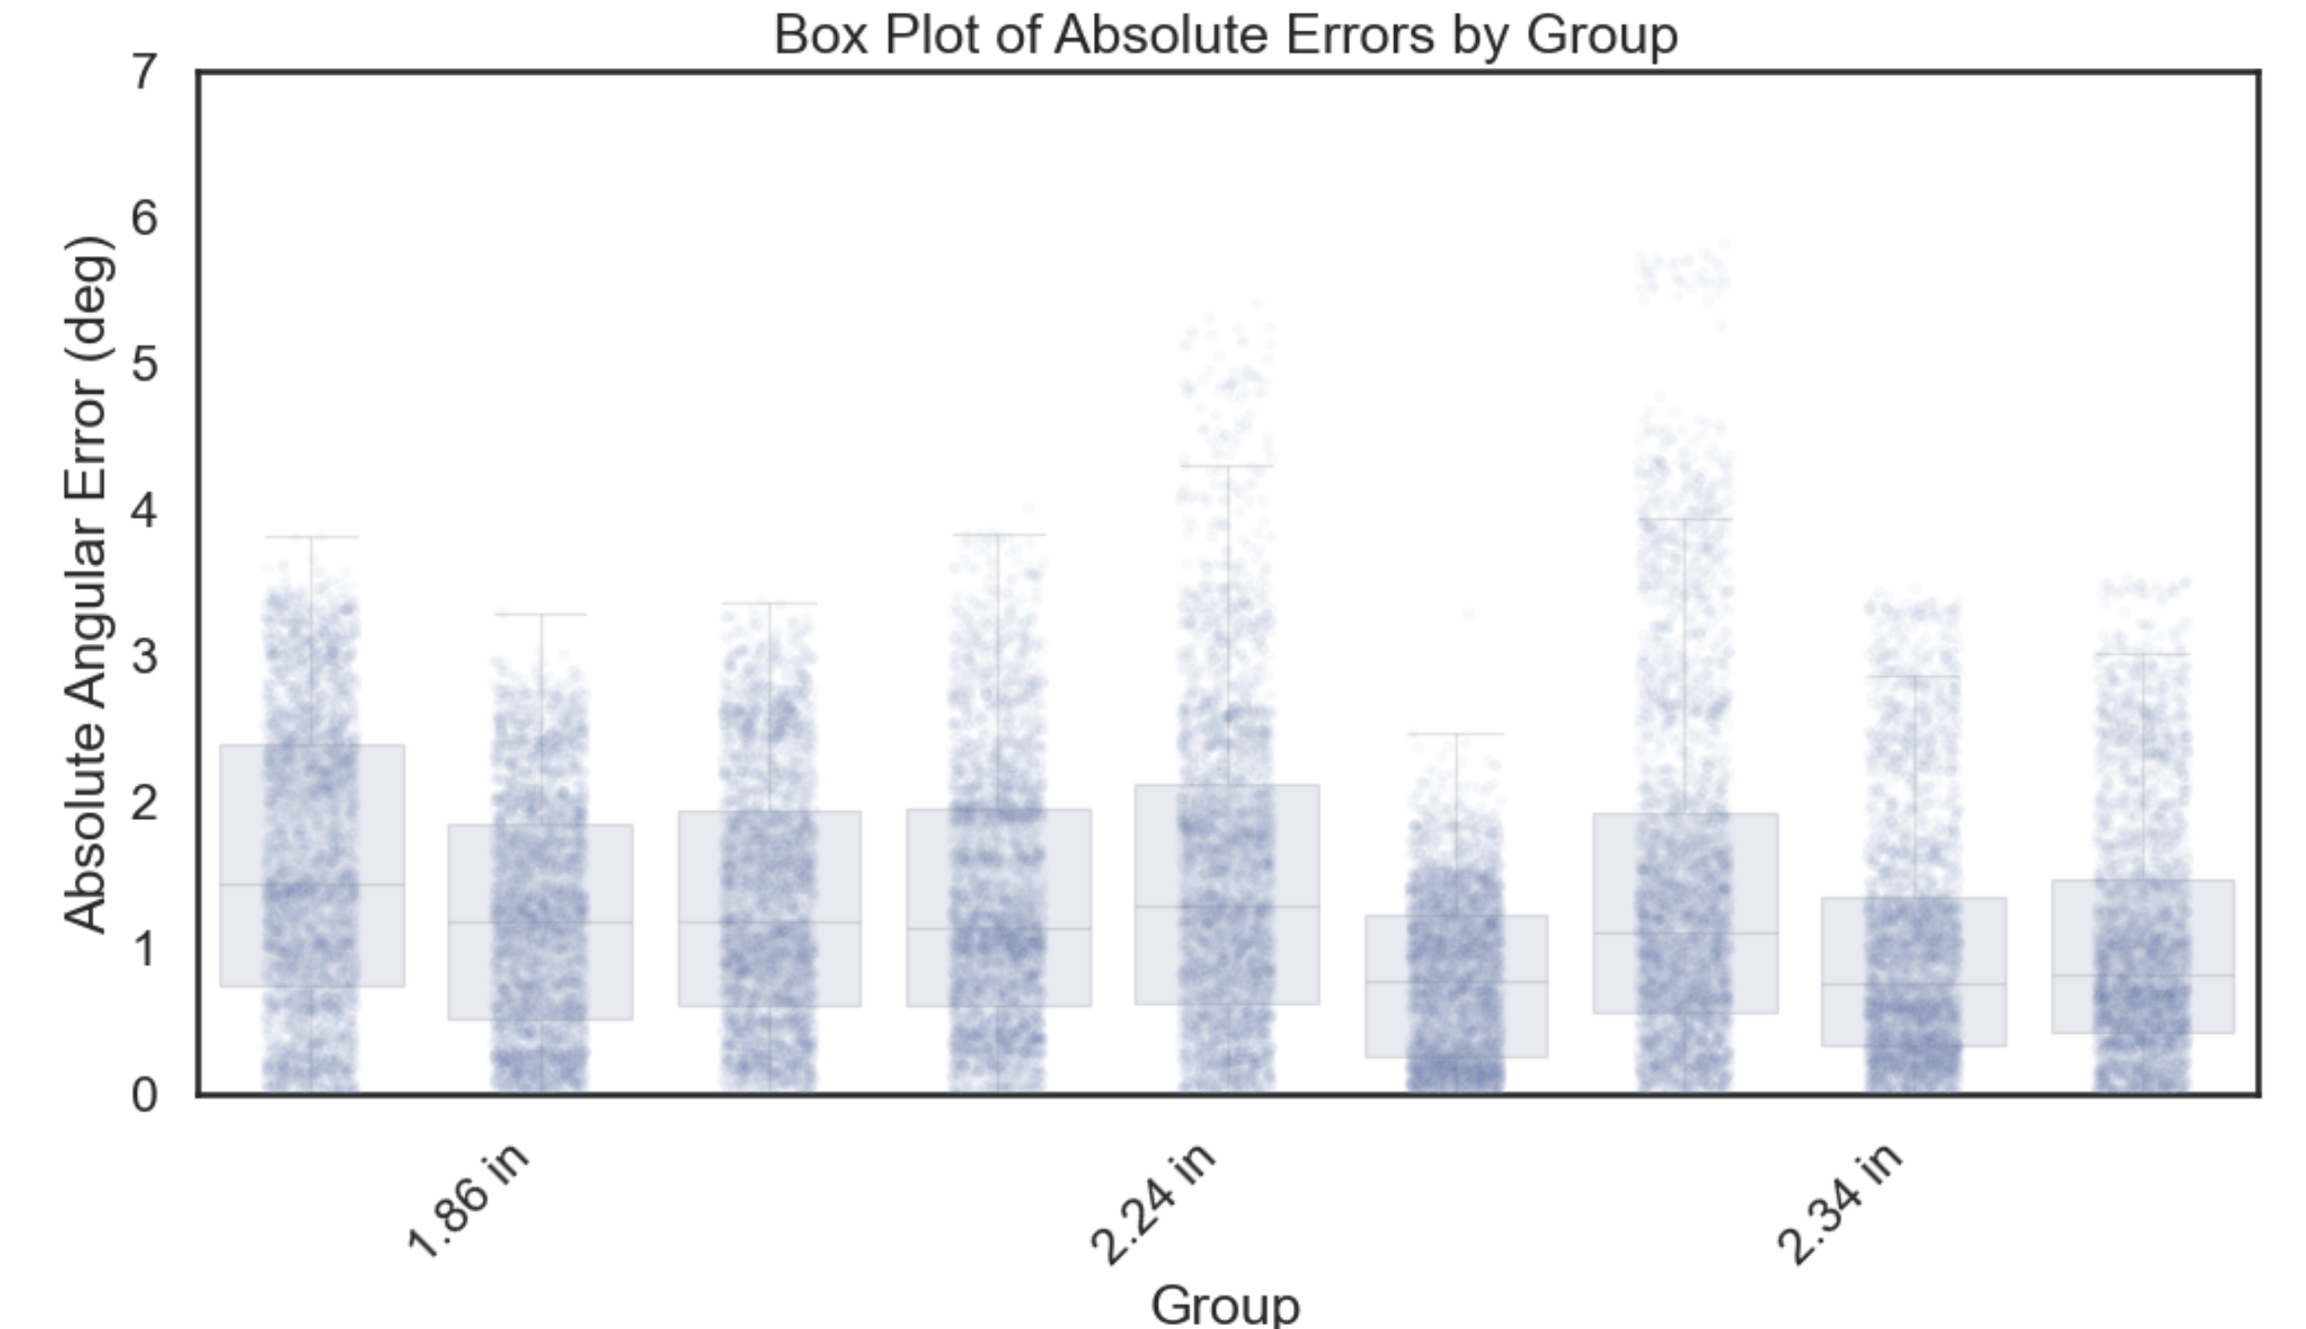
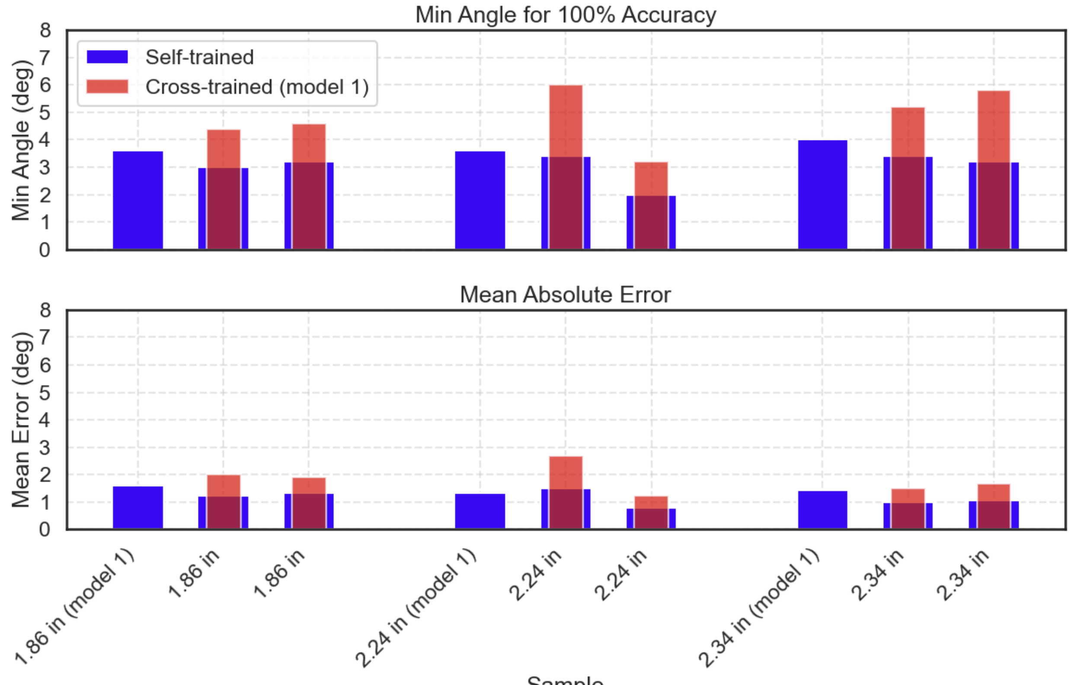
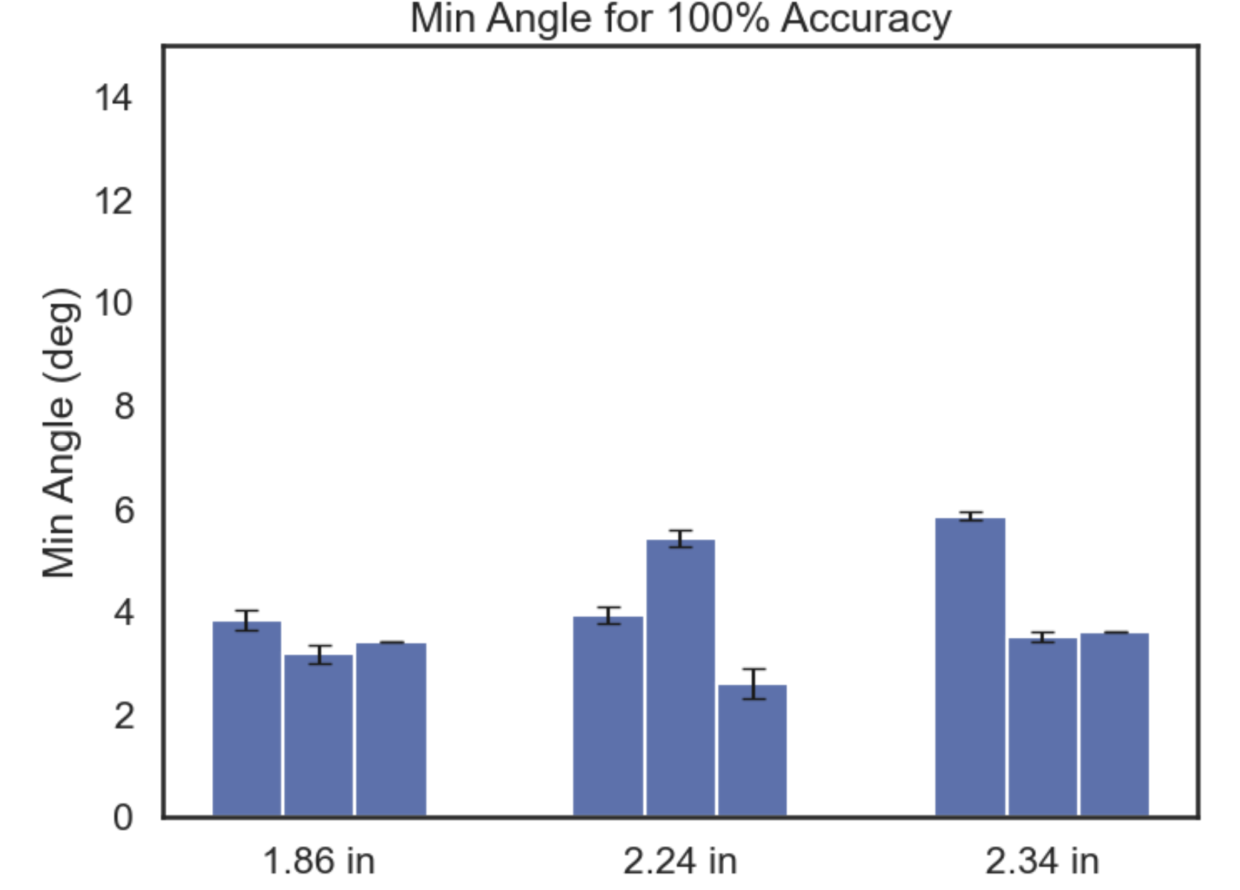
Reapplication Data Tested Using Velcro

Slide 5
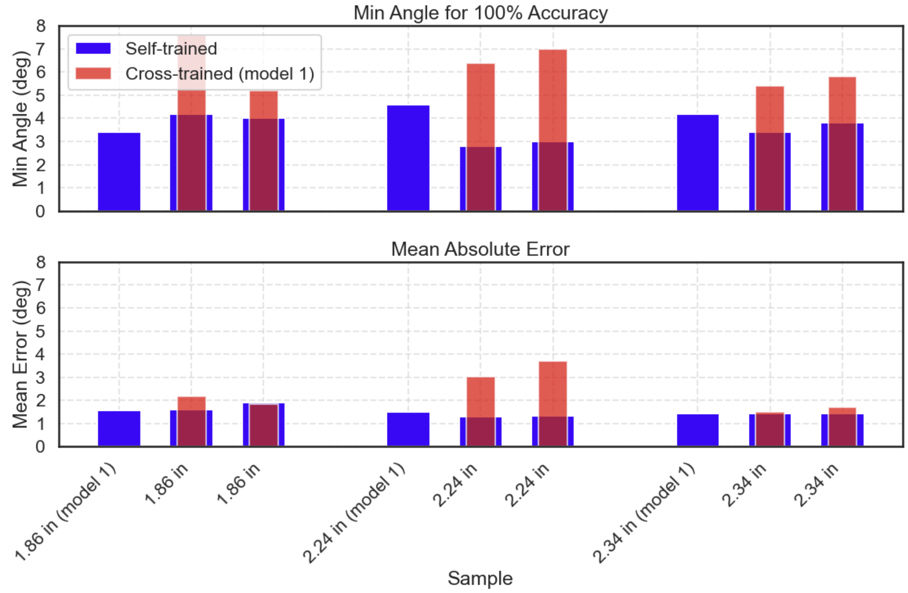
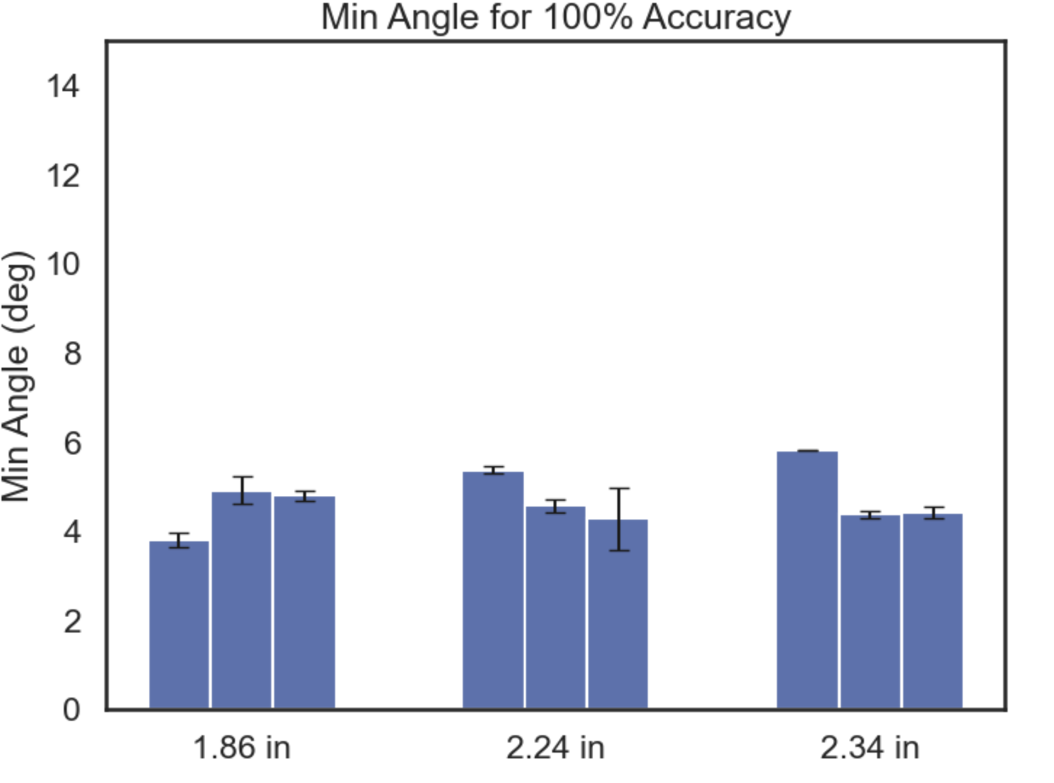
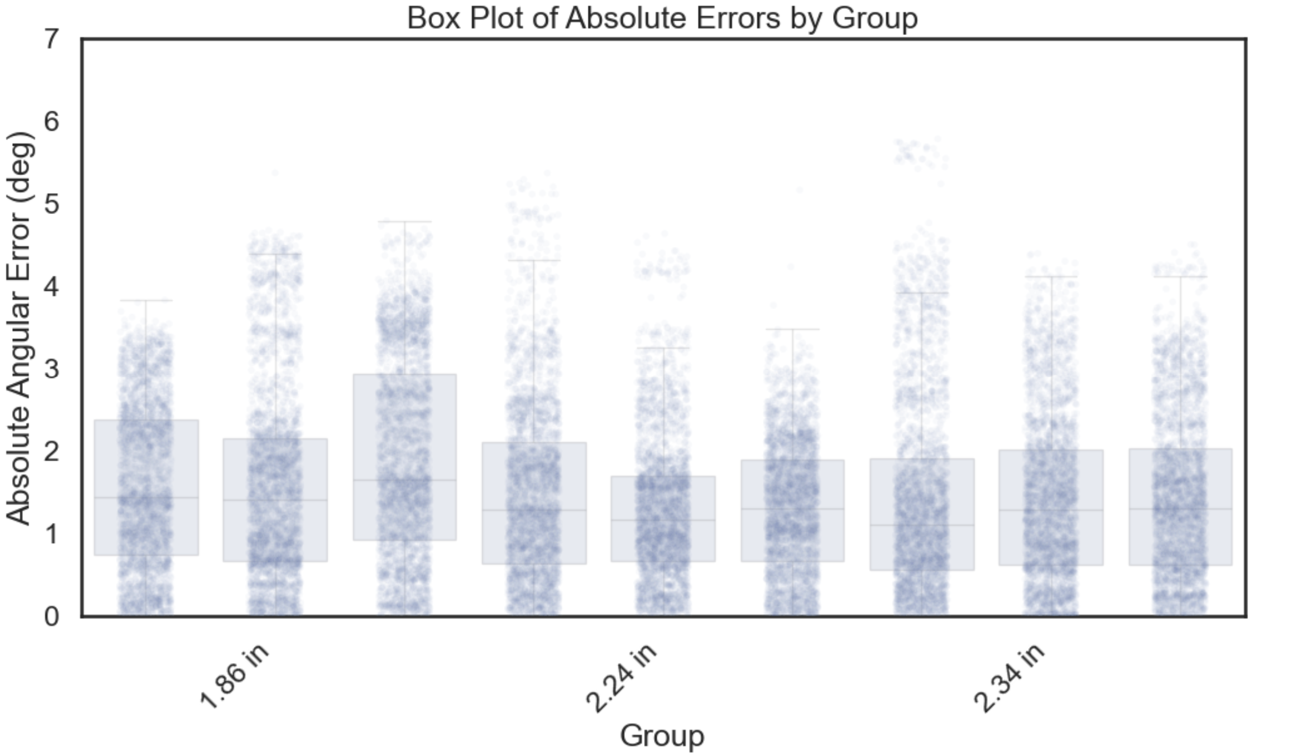
Misalignment Data Tested Using Velcro

Slide 6
To Do:
Plan was to finish making different cross-sectional area liquid metal channels today to test tomorrow: 0.017”x 0.017”, 0.02”x 0.02”, and 0.023” x 0.023”
0.01”x 0.01”, 0.02”x 0.02”, and 0.03” x 0.03”
Test new delta sigma ADC 24 bit with 128x gain possible using SPI communication protocol. If works, can use this for the PCB design since one chip can take up to 8 sensors and sampling frequency up to kHz range.
This board not needed for camera testing, just for final pcb design potentially
Order Camera equipment
Begin programming python code for data acquisition

Slide 7
Circuit V1 Option -> 7.5 mA
Strain Gauge (0.4 ohm – 1.2 ohm)
Practically no noise at rest!
GND
LT3092 7.5mA current source
(75K:100 ohm resistor ratio)
GND
OPA333
x831
2.048V ref MAX6070 (or 2.048V LM4040)
Circuit Component | Current Draw (mA)
Divider Circuit (LT3092) | ~ 7.5 mA
MAX6070 | ~ 0.2 mA
LMC6482 | ~ 0.6 mA
ADS115 or MCP3421 (16 bit) | ~ 0.22 mA
INA333 | ~0.05 mA
1.152 V –3.456V
(4mV – 11.59 mV)
GND
x2
MCP3421 I2C (16 bit resolution)
x50
Arduino

Slide 8
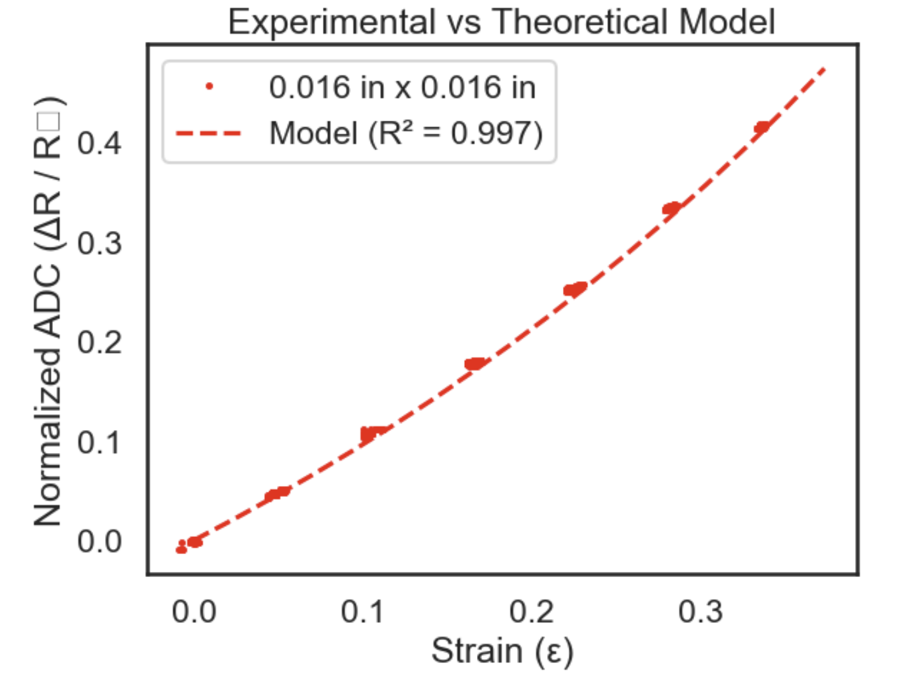
Theoretical Model vs. Channel Cross-Section

Slide 9
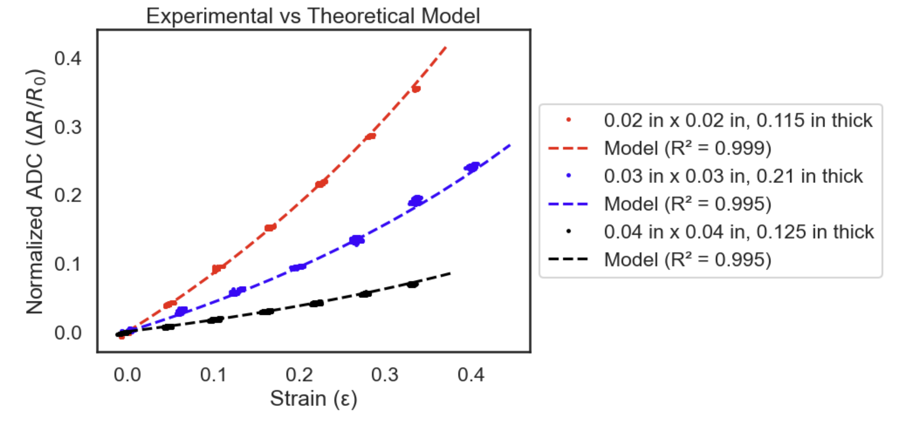
Model vs. Data for Different Cross-Sections

Slide 10
Circuit 5 for Camera Setup: 65 mA through each divider (can be adjusted to 15mA)
75 ohm
Strain Gauge (0.4 ohm – 1.2 ohm)
ADS115 I2C (two unique addresses 0x48, 0x49)
2.048V
GND
75 ohm
Strain Gauge (0.4 ohm – 1.2 ohm)
x 2
GND
2.048V
I2C
Rasberry Pi
75 ohm
Strain Gauge (0.4 ohm – 1.2 ohm)
GND
2.048V
75 ohm
Strain Gauge (0.4 ohm – 1.2 ohm)
x 2
GND
2.048V
ADM7150 3.3V 800 mA
X76 (LMC6482 or OPA333)
IMU
IMU
(two unique addresses, 0x28, 0x29)
GND
2.048V ref (LM4040 or MAX6070)
Circuit 5 for Camera Setup: same circuit has bench top testing with exception what ADC is ADS115, not MCP3421, to handle the higher sampling frequency at 16 bit -> 200-500 Hz

Slide 11
Circuit PCB for PCB Differential Setup: Option 1
Strain Gauge (0.4 ohm – 1.2 ohm)
ADS115 I2C (two unique addresses 0x48, 0x49)
7.5 mA
2.048V
GND
Strain Gauge (0.4 ohm – 1.2 ohm)
x 2
7.5 mA
GND
2.048V
I2C
Rasberry Pi
Strain Gauge (0.4 ohm – 1.2 ohm)
7.5 mA
GND
2.048V
Strain Gauge (0.4 ohm – 1.2 ohm)
x 2
7.5 mA
GND
2.048V
LT3092
(Current Source)
X76 (LMC6482 or OPA333)
IMU
IMU
(two unique addresses, 0x28, 0x29)
GND
2.048V ref (LM4040 or MAX6070)

Slide 12
Evaluating Different ADC’s For Final PCB Design
ADC | Single, Diff, or Both | PGA | Bit Resolution | SPS (max) | Communication | OpAmp? Ref V? | ADC Clipping?
ADS115 | Both | 16 | 16 | 820 | I2C | Yes, No | Yes if Differential
AD7140 | Both | 128 | 24 | 19.2K | SPI | No, No | No
MCP3564 | Both | 128 | 24 | 152K | SPI | No, No | No

Slide 13
Circuit PCB for PCB: Option 2 Single Ended ADC (No Resistor Dividers, Opamps, or Volt Ref)
Strain Gauge (0.4 ohm – 1.2 ohm)
7.5 mA
AD7124 SPI (8 single ended channels)
GND
Strain Gauge (0.4 ohm – 1.2 ohm)
7.5 mA
GND
4x Analog in
x 128
RP2040
Strain Gauge (0.4 ohm – 1.2 ohm)
7.5 mA
GND
GND
Strain Gauge (0.4 ohm – 1.2 ohm)
7.5 mA
GND
LT3092
(Current Source)
IMU
IMU
(two unique addresses, 0x28, 0x29)
GND

Slide 14
6/18/25: AD7124-4 Working: Try diff mode next time!
AD7124-4
100 ohm
ESP-WROOM-32
(3.3V)
Ch0
100 ohm
Ch1
Ch4
GND
470 ohm
470 ohm
Ch2
Ch3
3.3V ref in from ESP 3.3V pin
(LM4040 2.048V didn’t work??)

Slide 15
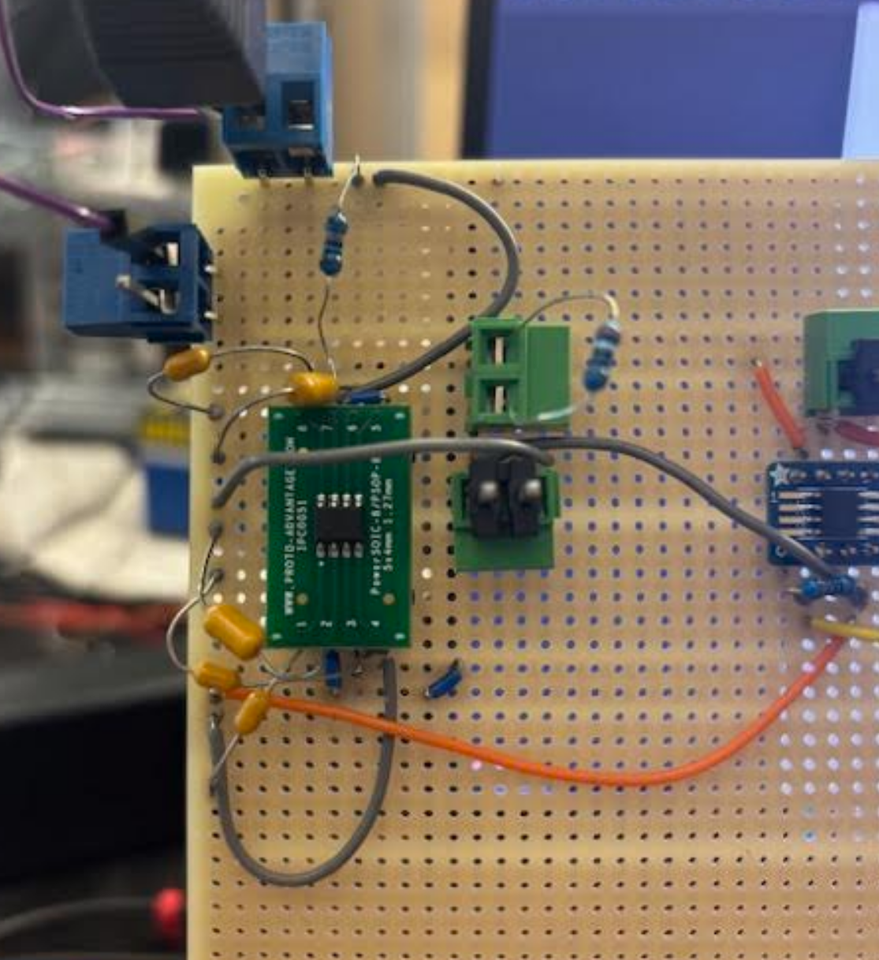
6.2 V supply
GND

Slide 16
7/7/25: Completed or In Progress
4 strain gauge board with 4 current sources done
Stream 4 independent strain gauge data via Arduino and spi and ad7124 adc done
Rasberry Pi flash new OS Kuiper Linux done
Connect to adc via Rpi and python in progress
Installed SpinMaker SDK on windows for camera capture streaming done
Need dedicated usb 3 splitter and power supply to run both cameras simultaneously waiting for usb 3 hub to arrive today
Successfully ran Preeya Single Camera capture python code done
Run dual camera python code In progress
Triggering single camera withRPI GPIO in progress (conceptually very simple and clear)

Slide 17
7/14/25: Completed or In Progress
4 strain gauge board with 4 current sources done
Stream 4 independent strain gauge data via Arduino and spi and ad7124 adc done
Rasberry Pi flash new OS Kuiper Linux done
Connect to adc via Rpi and python done
Installed SpinMaker SDK on windows for camera capture streaming done
Need dedicated usb 3 splitter and power supply to run both cameras simultaneously done
Successfully ran Preeya double Camera capture python code in progress
Run dual camera python code In progress
Triggering each camera withRPI GPIO done

Slide 18
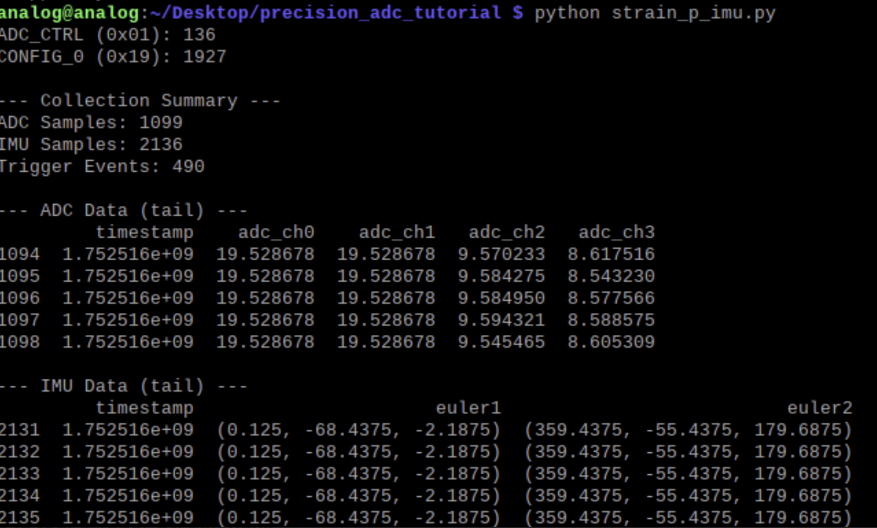
Data as DataFrame -> CSV

Slide 19
7/21/25

Slide 20
Circuit PCB for PCB:
Strain Gauge (0.4 ohm – 1.2 ohm)
7.5 mA
4x OPA333 x Gain??
AD7124-8 SPI (4 diff channels)
GND
Strain Gauge (0.4 ohm – 1.2 ohm)
7.5 mA
GND
4x Analog in
SPI Output to Arduino
Strain Gauge (0.4 ohm – 1.2 ohm)
7.5 mA
GND
Strain Gauge (0.4 ohm – 1.2 ohm)
7.5 mA
GND
LT3092 x 4
(Current Source)
MAX6070 Prec. Volt Ref. 2.048V
3.3V

Slide 21
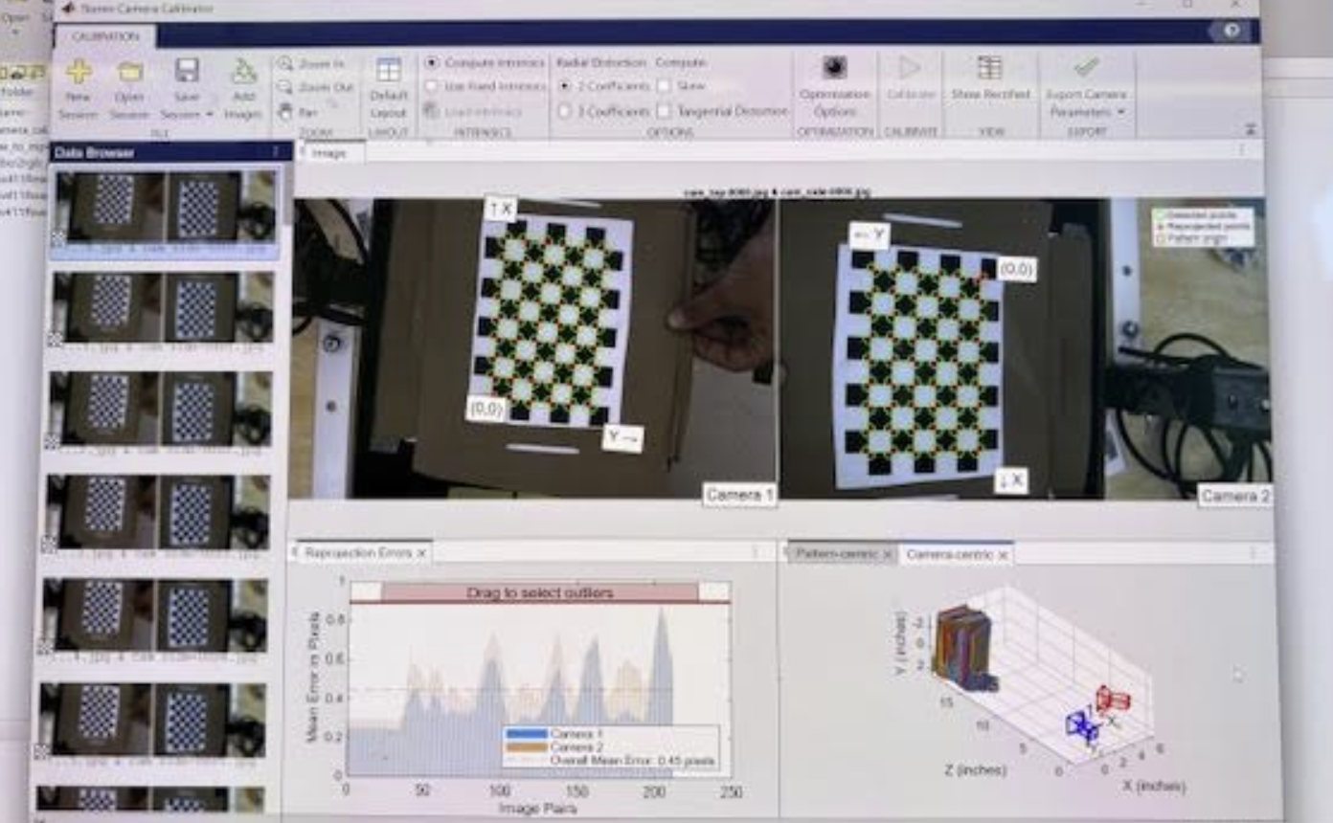
Stereo Camera Calibration

Slide 22
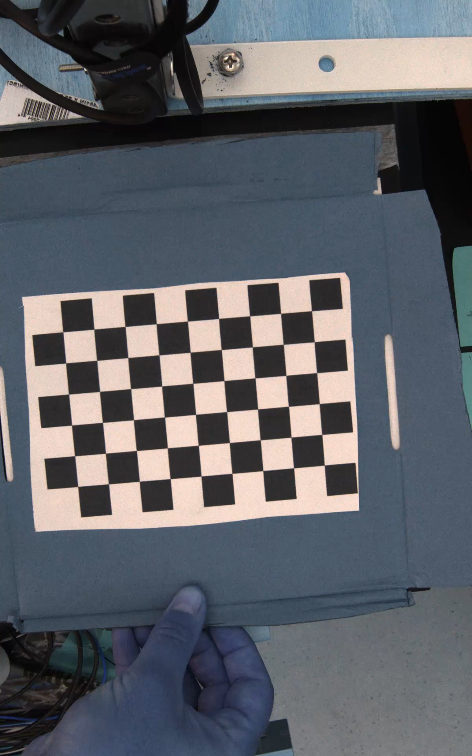
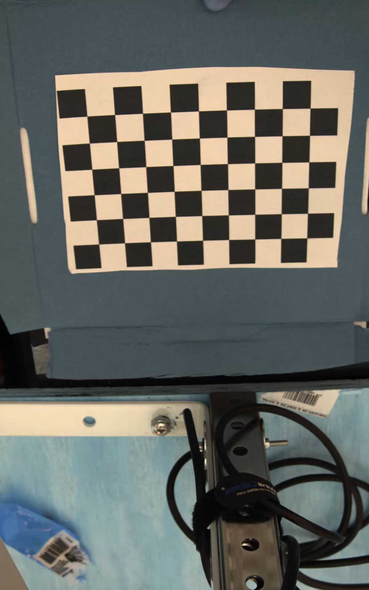
Converting Raw to MP4

Slide 23
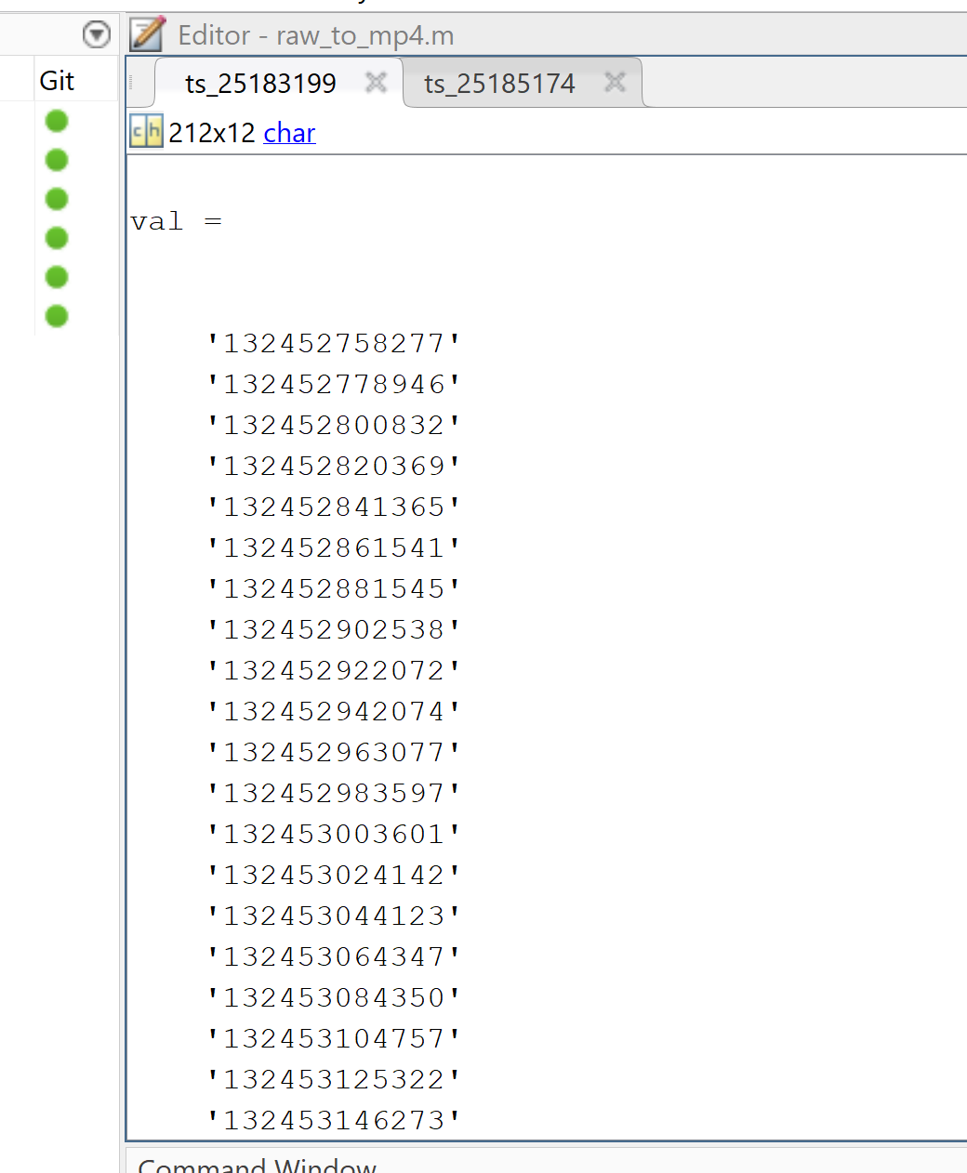
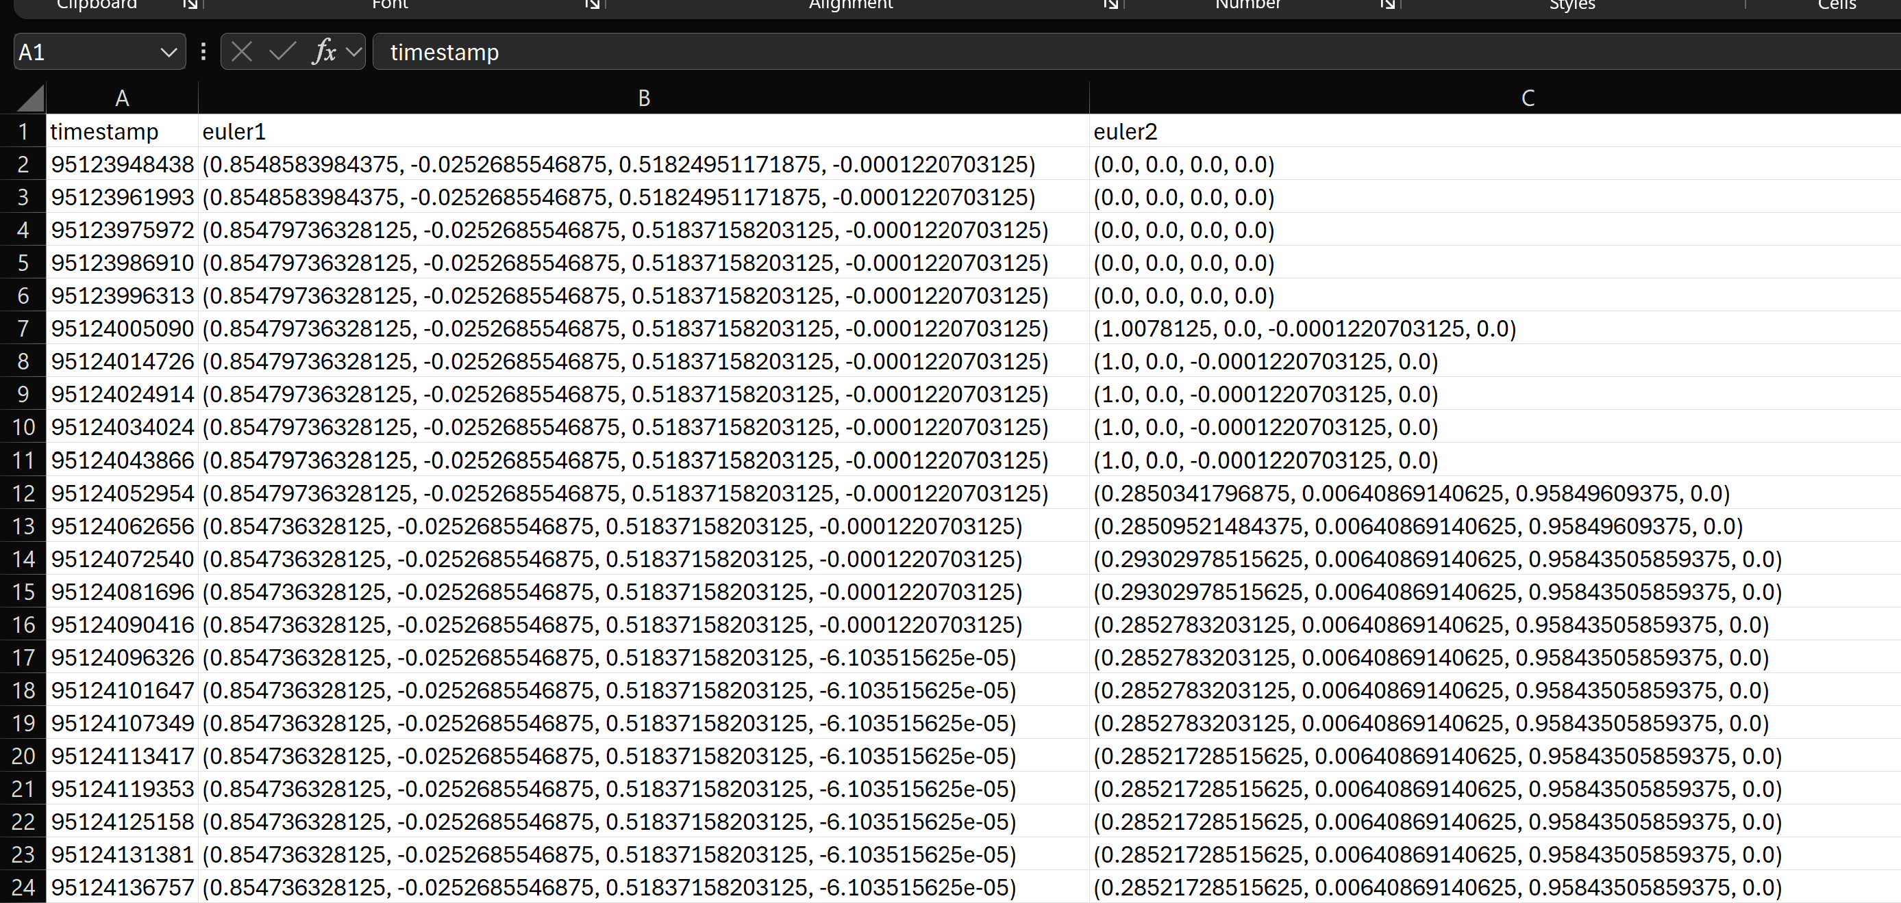
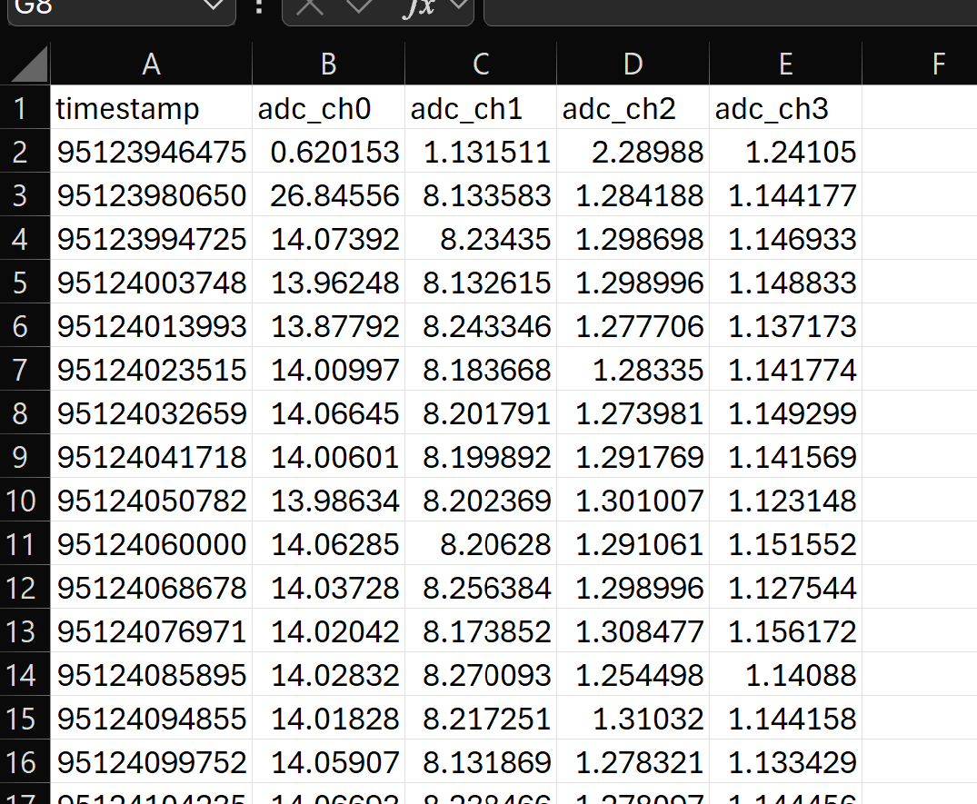
Timestamp Alignment from Three Threads:
%H%M%S%f
(Thread 3) GPIO Triggers
(Thread 1) ADC – 4 channels
(Thread 2) IMU – Quat – 2 sensors

Slide 24

To Do Next: Get Familiar with DLC

Slide 25
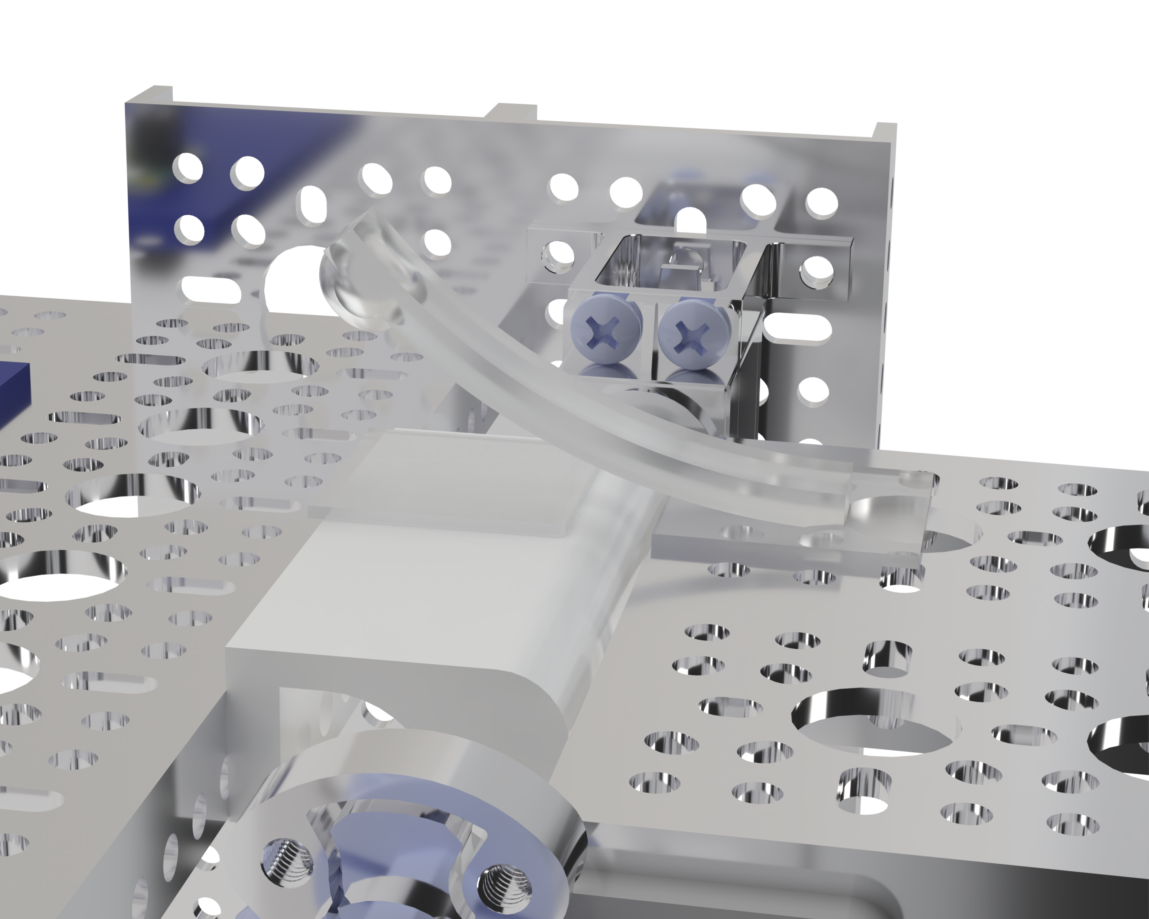
To Do Next: Use DLC 3D and Autobender

Slide 26
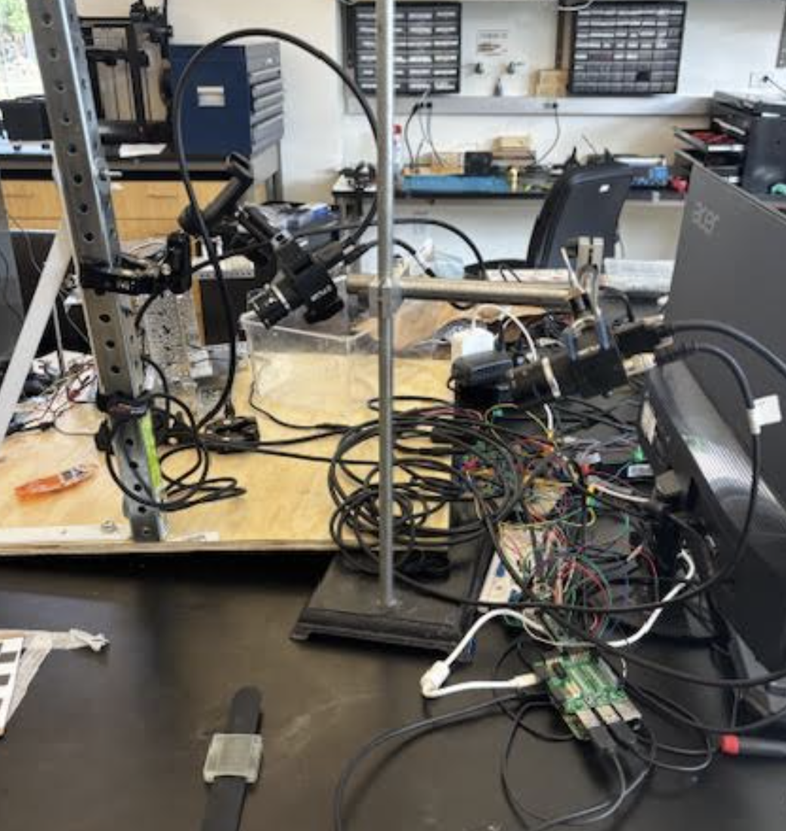
7/28/2025:

Slide 27
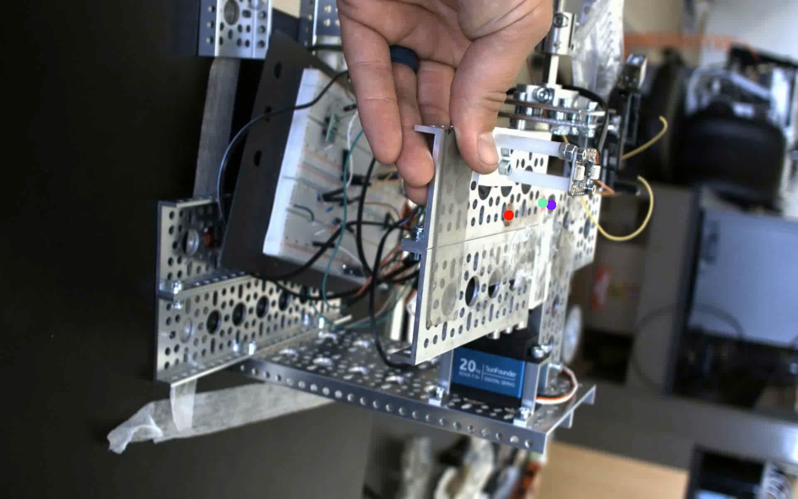
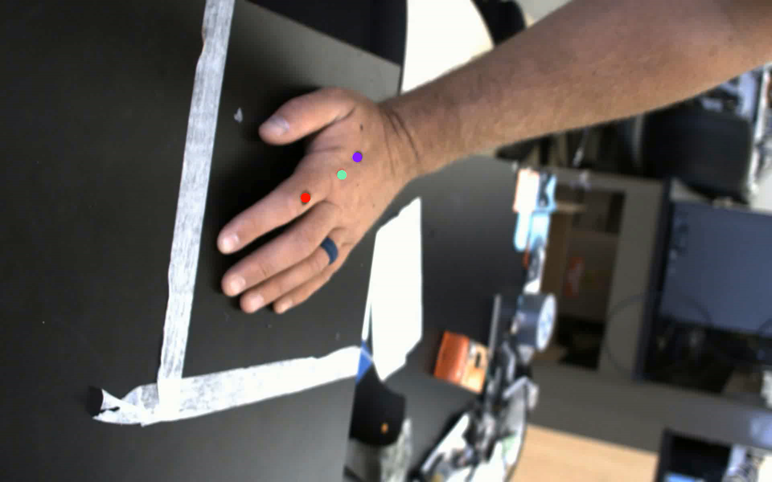
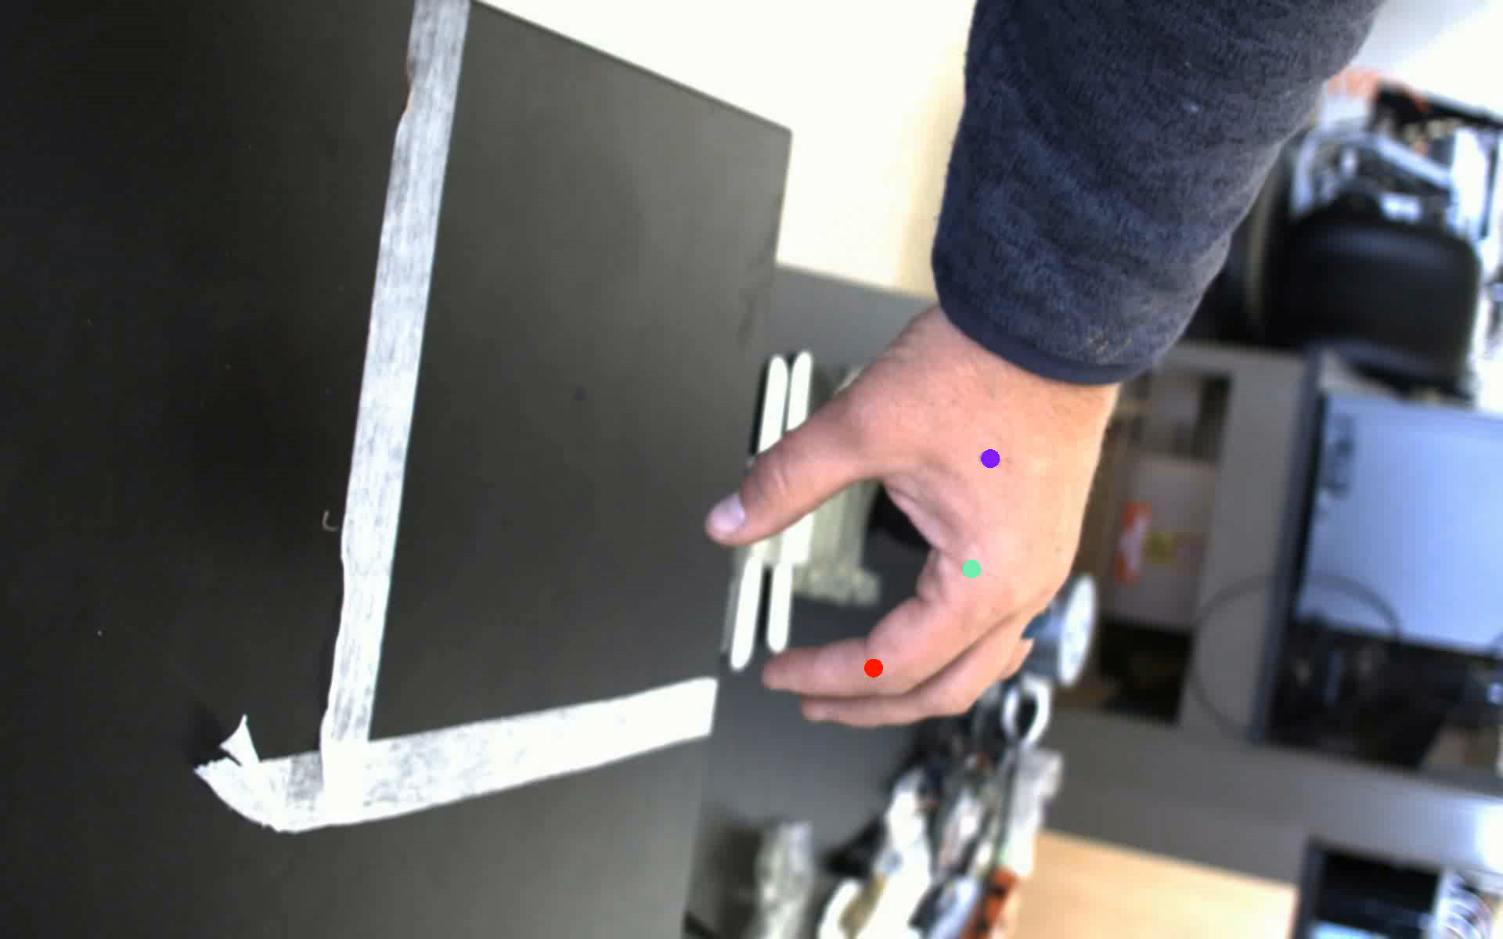
DLC Training Results Camera 1 10 x 4 second videos taken

Slide 28
7/28/2025: DLC Training Results Camera 2
Working on Today

Slide 29
8/18/2025: Updates
Created DLC3DBendAngles class in python in analysis.py
Includes aligning of timestamps
Wrote camera_encoder_cal.ipynb to analyze camera data and compare to rotary encoder
Wrote IMU vs Encoder.ipynb to analyze imu data and compare to rotary encoder
Quaternions converted to Euler Angles
Euler Angles to Unit Vectors
Get angle between two vectors to calculate bend angle
Updated Fig 1 and Started Fig 2

Slide 30
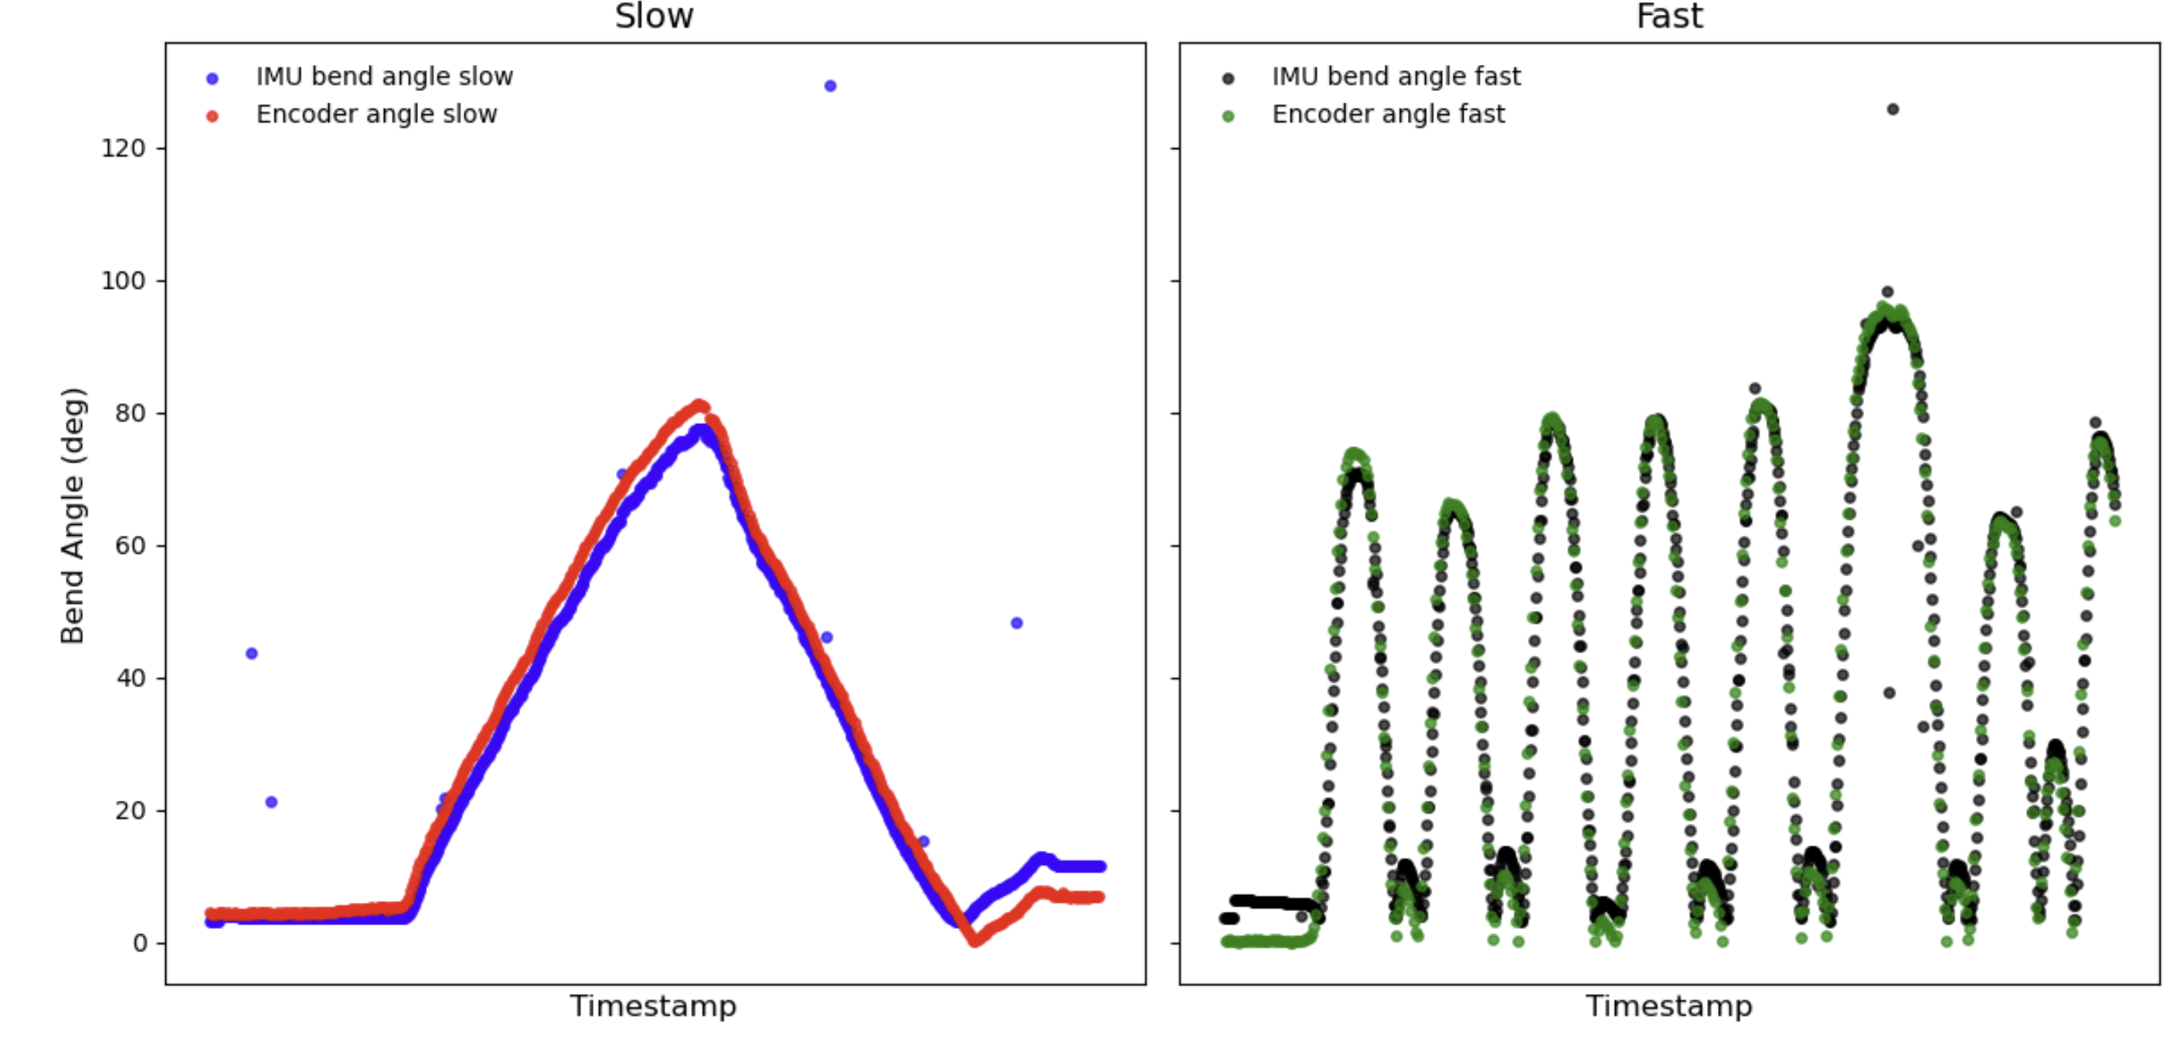
8/18/2025: IMU AutoBender Results

Slide 31
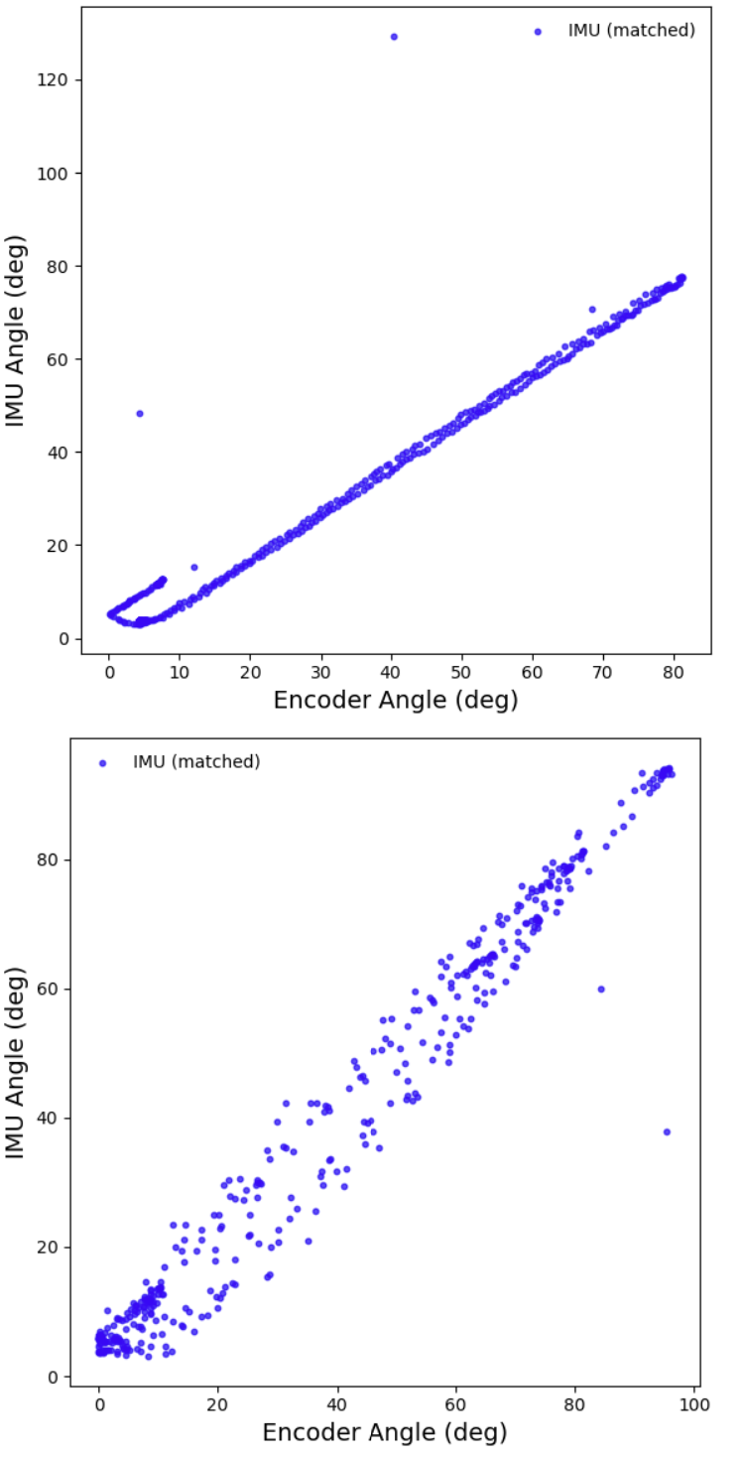
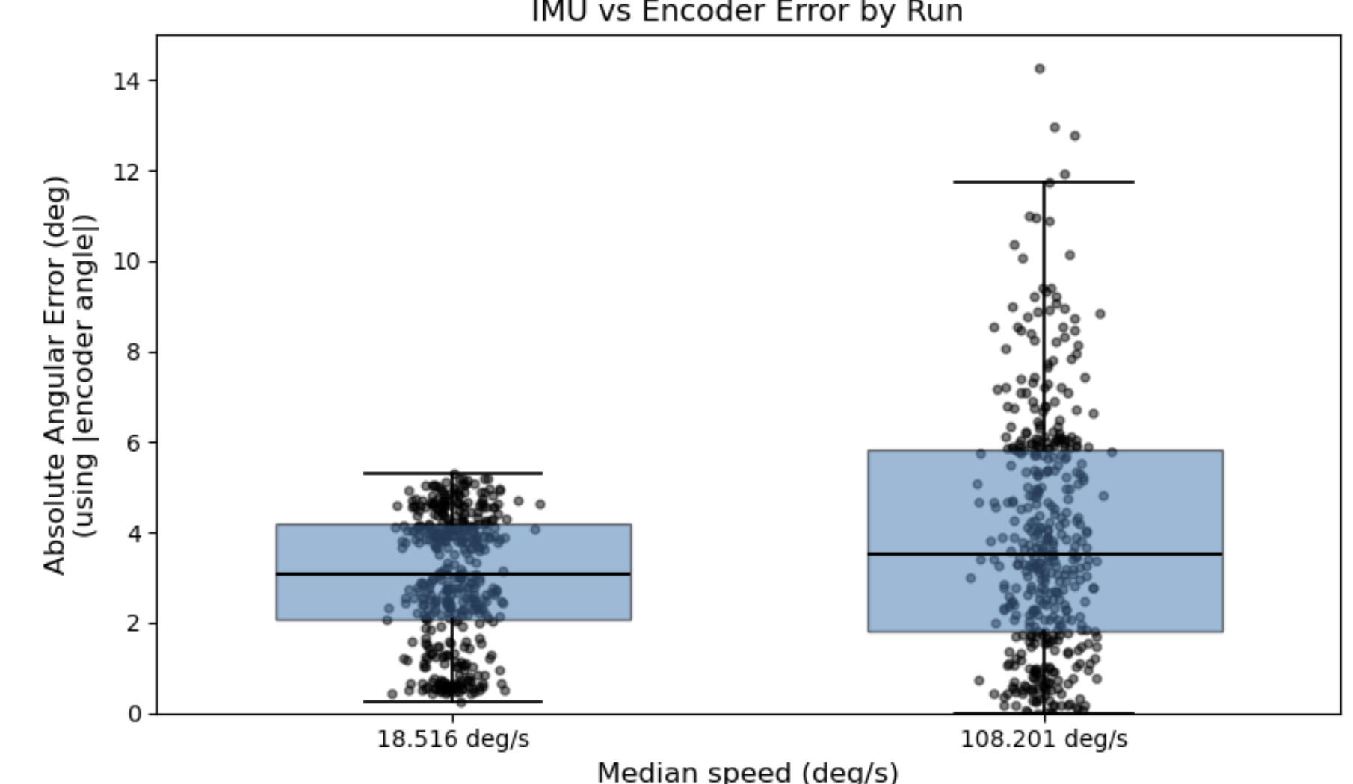
8/18/2025: IMU AutoBender Results

Slide 32
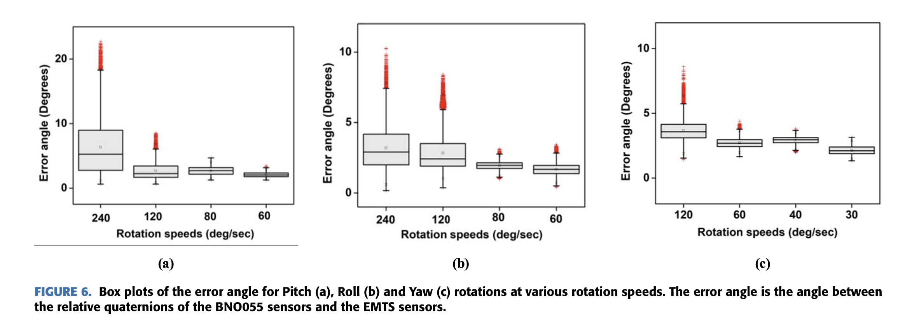
8/18/2025: IMU AutoBender Results
Shenoy et al (2022)

Slide 33
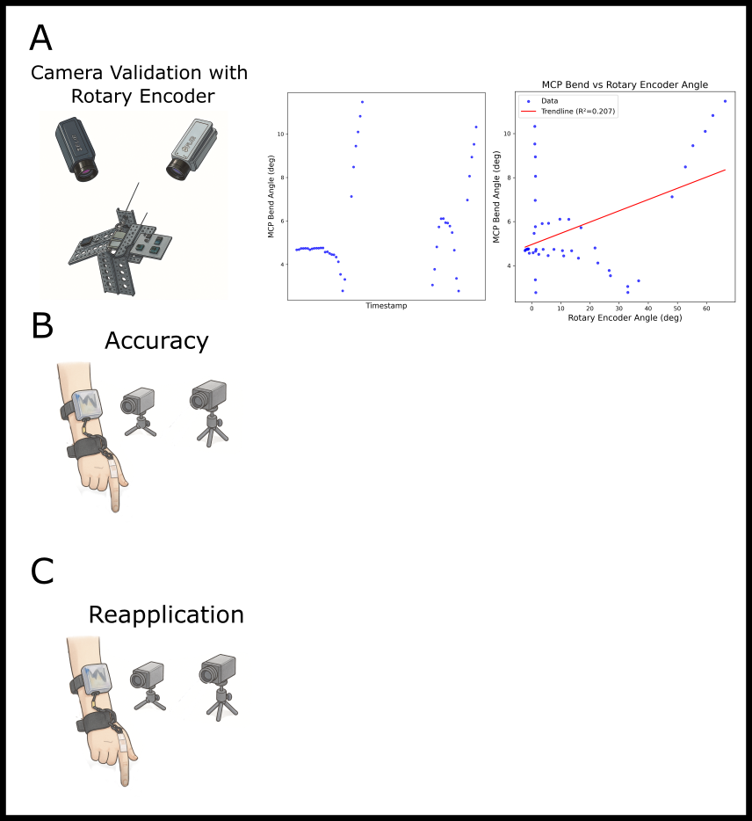
8/18/2025: IMU AutoBender Results

Slide 34
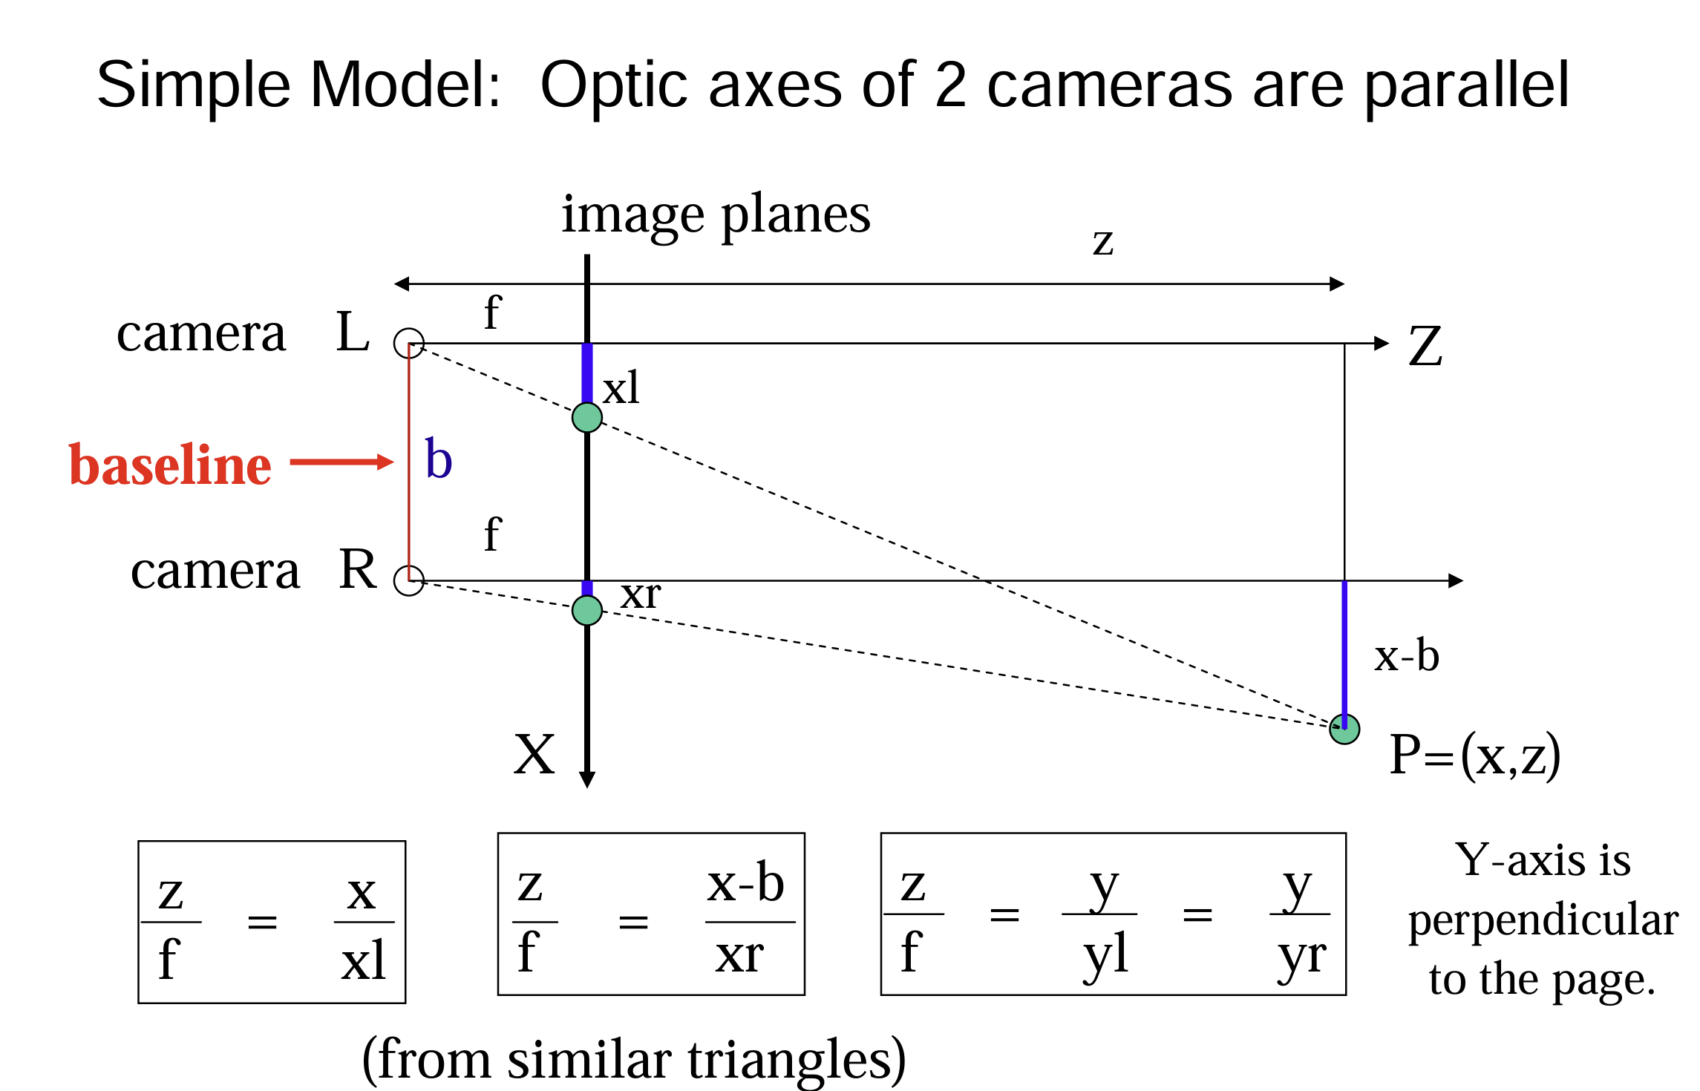
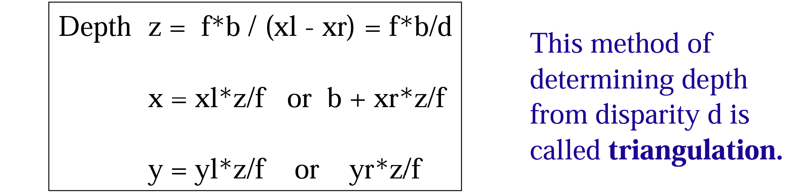
StereoCamera 3D Reconstruction
2.1. Triangulation — Image Processing and Computer Vision 2.0 documentation
Computer Vision: Stereo

Slide 35
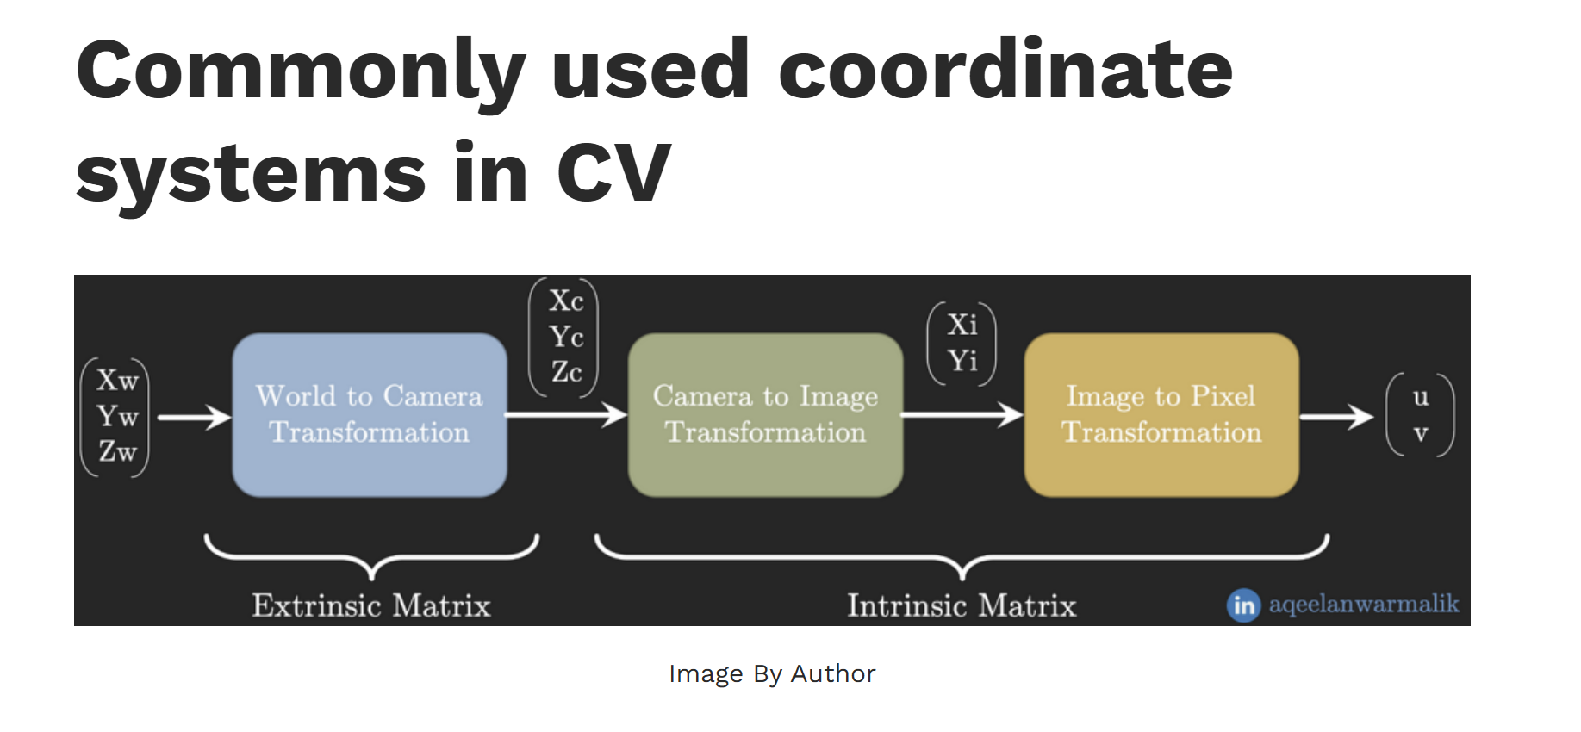
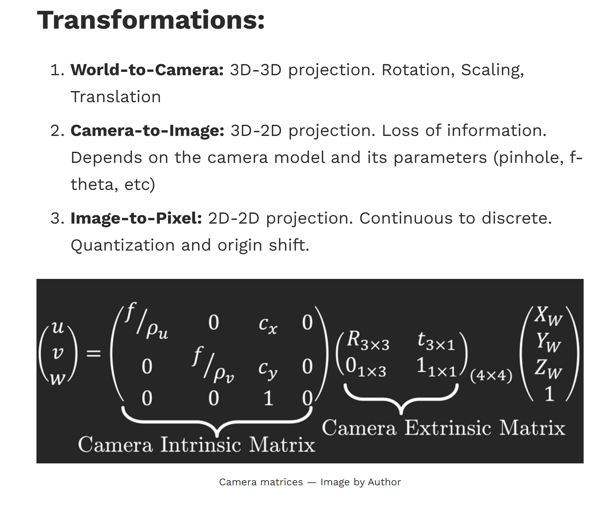
What are Intrinsic and Extrinsic Camera Parameters in Computer Vision? | Towards Data Science

